Slide 1
Introduction to Ions

Slide 2
Welcome to this Smart Lesson! After you have completed this lesson, you should be able to:
Define the terms ion, cation and anion.
Explain how and why ions form, in terms of electron configurations.
State the names and symbols of the ions formed by the first 20 elements of the periodic table, plus other selected elements (Cu, Fe, Pb, Zn, Ag).

Slide 3

Ions are essential for life: if there were no ions, your body would not function! The cells in your body use ions to communicate.
Ions are also what make up crystals in the Earth's crust, and lightning in the atmosphere.

Slide 4
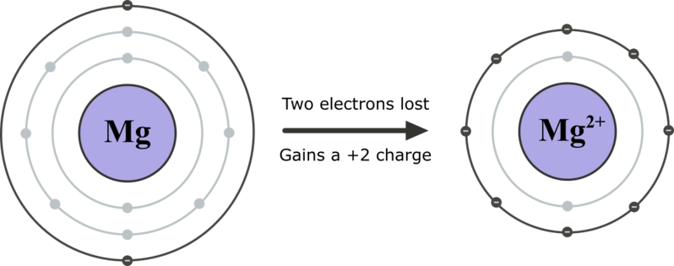
Ions are charged particles that form when an atom or molecule loses or gains electrons.
Atoms are most stable when their valence (outer) electron shell is full of electrons. Atoms without full valence shells can gain or lose electrons to become stable, and in the process they become ions.

Slide 5
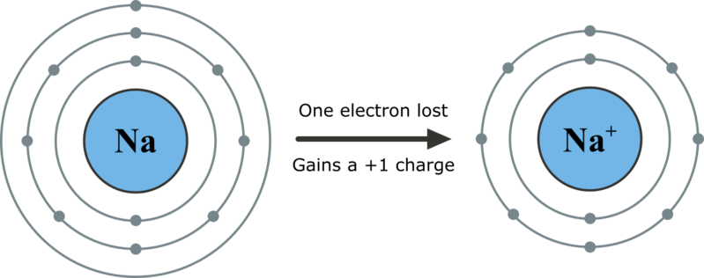
How do we name different types of ions?
Cations have the same name as their parent atom, with "ion" added to the end.
For example, a sodium atom becomes a sodium ion.

Slide 6
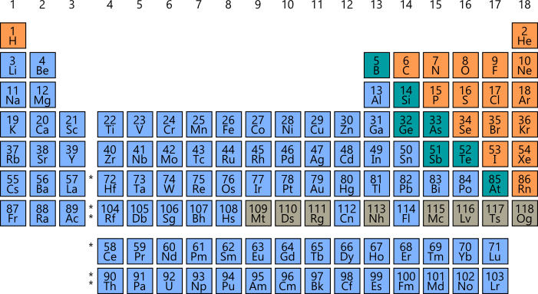
Metal atoms, found on the left-hand side and middle of the periodic table, form cations. Hydrogen also forms a cation although it is a non-metal.
If the element is found on the left-hand side of the periodic table, there's a good chance the name of the ion is the same as the name of the atom.

Slide 7
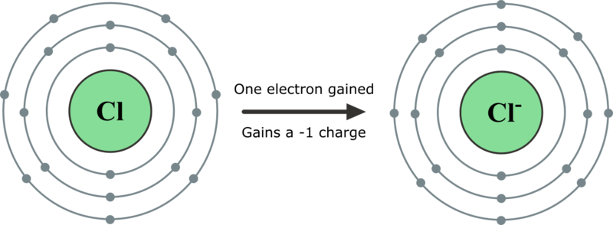
Anions have different names to their parent atom.
The end of the element's name is replaced with -ide. For example, a chlorine atom becomes a chloride ion.

Slide 8
Non-metal atoms, found on the right-hand side of the periodic table, form anions. These are shown in orange on the periodic table below.
Elements in group 15,16 and 17 will all form ions with different names to their parent atom.

Slide 9
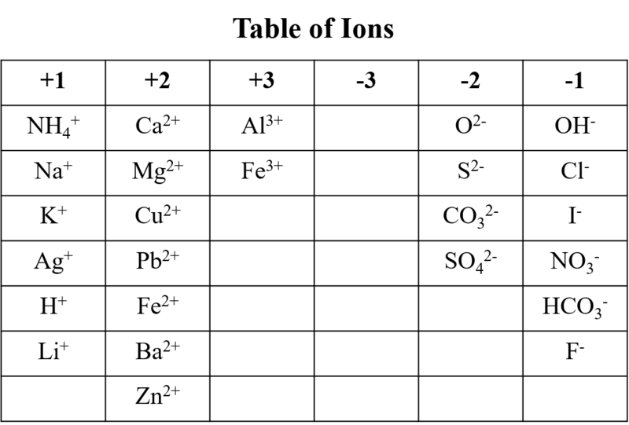
In your exam, you'll be given a table of ions like the one below. It will not have any of the names of the ions on it, only their symbols. You will need to remember the names of the given ions.

Slide 10

Watch the video below (5:35) to learn how to speak Chemistrian (in other words, how to name ions).

Slide 11
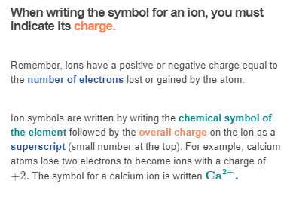

Slide 12
